Slide 1
Uva 1169
Robotruck
SWERC 2007, LA3983
Time: 3 seconds

Slide 2
Problem Description (1/4)
This problem is about a robotic truck that distributes mail packages to several locations in a factory. The robot sits at the end of a conveyer at the mail office and waits for packages to be loaded into its cargo area.
The robot has a maximum load capacity, which means that it may have to perform several round trips to complete its task. Provided that the maximum capacity is not exceeded, the robot can stop the conveyer at any time and start a round trip distributing the already collected packages. The packages must be delivered in the incoming order.

Slide 3
Problem Description (2/4)
The distance of a round trip is computed in a grid by measuring the number of robot moves from the mail office, at location (0,0), to the location of delivery of the first package, the number of moves between package delivery locations, until the last package, and then the number of moves from the last location back to the mail office. The robot moves a cell at a time either horizontally or vertically in the factory plant grid.

Slide 4
Problem Description (3/4)
For example, consider four packages, to be delivered at the locations (1,2), (1,0), (3,1), and (3,1). By dividing these packages into two round trips of two packages each, the number of moves in the first trip is 3+2+1=6, and 4+0+4=8 in the second trip. Notice that the two last packages are delivered at the same location and thus the number of moves between them is 0.
(1, 2)
3
(3, 1)
4
0
(3, 1)
2
(3, 1)
(3, 1)
(0, 0)
(0, 0)
1
(1, 0)
4

Slide 5
Problem Description (4/4)
Given a sequence of packages, compute the minimum distance the robot must travel to deliver all packages

Slide 6
Input (1/2)
Input consists of multiple test cases. The first line of the input contains the number of test cases. There is a blank line before each dataset.
The input for each dataset consists of a line containing one positive integer C, not greater then 100, indicating the maximum capacity of the robot, a line containing one positive integer N, not greater than 100,000, which is the number of packages to be loaded from the conveyer.

Slide 7
Input (2/2)
Next, there are N lines containing, for each package,
two non-negative integers to indicate its delivery location in the grid,
and a positive integer to indicate its weight.
The weight of the packages is always smaller than the robot’ s maximum load capacity.
The order of the input is the order of appearance in the conveyer.

Slide 8
Output
For each test case, print one line containing one integer representing the minimum number of moves the robot must travel to deliver all the packages. Print a blank line between datasets.

Slide 9

Sample Input / Output
Number of test cases
14
1
10 4
1 2 3
1 0 3
3 1 4
3 1 4
Capacity
Number of packages
(x, y, weight)
(1, 2)
3
(3, 1)
2
(3, 1)
(0, 0)
14
(1, 0)
4
0
(3, 1)
(3, 1)
(0, 0)
4

Slide 10
Sample Input / Output
14
Number of test cases
1
10 4
1 2 3
1 0 3
3 1 4
3 1 4
Capacity
Number of packages
(1, 2, 3)
(x, y, weight)
3
2
4
(3, 1,4)
(3, 1, 4)
(0, 0)
20
(1, 0, 3)
3
4
(3, 1,4)
(0, 0)
4

Slide 11

Solution
Let d[i] 代表將前 i 個 packages 收完的minimum moves
d[i] = min{ d[j] //撿到 j的 最小 moves
+d2o(j+1) //(0,0) 走到 j+1 的 moves
+dist(j+1,i) //從 (j+1) 收到 i 的moves
+d2o(i) //從 i 走回(0,0) 的moves
, where j $≤$i, w(j+1,i)$≤$C }
d[j]
(0,0)
第 j+1
第 i
d2o(j+1)
dist(j+1, i)
d2o(i)

Slide 12

Solution
Let total_dist(i) 表示從第1個垃圾, 2, 3 …, 到最終 i 的總距離
dist(j+1, i) = total_dist(i)-total_dist(j+1)
d[i] = min{ d[j]
+d2o(j+1)
-total_dist(j+1)
, where j $≤$i, w(j+1,i)$≤$C}
+total_dist(i)+d2o(i)
Let f(j)=d[j]-total_dist(j+1)+d2o(j+1)

Slide 13

Solution
Let total_dist(i) 表示從第1個垃圾, 2, 3 …, 到最終 i 的總距離
dist(j+1, i) = total_dist(i)-total_dist(j+1)
d[i] = min{ f(j)
, where j $≤$i, w(j+1,i)$≤$C}
+total_dist(i)+d2o(i)

Slide 14

Solution
O(n)
d[i] = min{ f(j)
, where j $≤$i, w(j+1,i)$≤$C}
+total_dist(i)+d2o(i)
因為 w 都是正的。 範圍 i 會越來越大, 往右移
範圍 j 也會動態 往右移
C=8
j
i
j | 1 | 2 | 3 | 4 | 5 | 6 | 7
weight[j] | 2 | 3 | 2 | 1 | 3 | 2 | 3
f(j) |  | 2 | 5 | 4 | 3
╳
C=8
j
i
j | 1 | 2 | 3 | 4 | 5 | 6 | 7
weight[j] | 2 | 3 | 2 | 1 | 3 | 2 | 3
f(j) |  | 2 |  | 4 | 3
╳

Slide 15
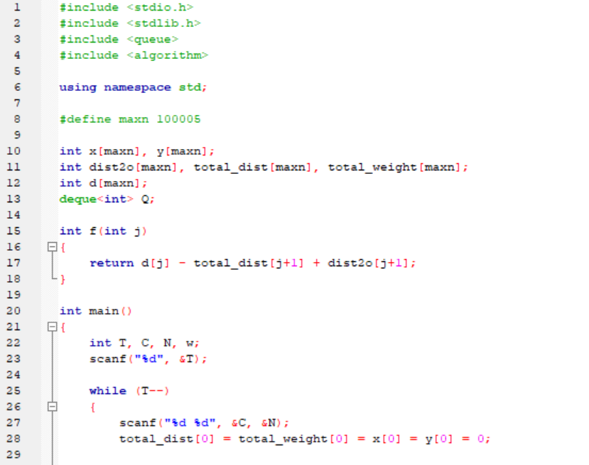

Slide 16
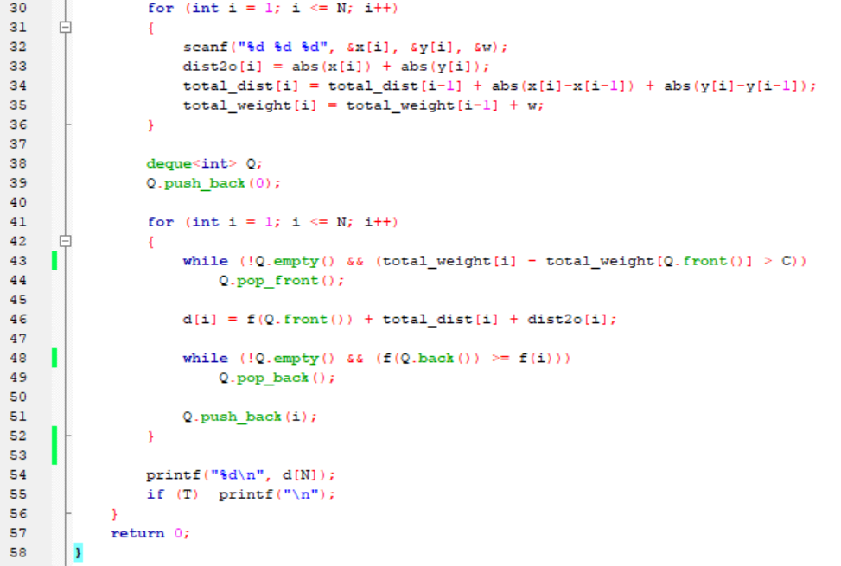
Prefix

